Slide 1

Patient-centred information exchange system

Slide 2
Problems
Due to increase in number of patients day by day, it is getting difficult for doctors to manage every patient and keep a track of their records.
Test report files makes a huge pile and it gets hard to sort all of them.
Billing process takes a longer time to get to patient.
In current pandemic situation, it is quiet difficult for doctors to reach out every bed.

Slide 3
Our Vision
Promoting a paperless work environment, thus increasing the efficiency of hospitals to manage and access their records in a more precise way and to achieve this goal, we will develop a software program.

Slide 4
What will the software do?
By using this software,
The readings of devices will be sent from the bed directly to doctor's phone/tablet through a secured and specified network
The labs will upload the reports on the system which makes them accessible from any place.
Doctors don’t need to remember every detail of their patients as they can have everything on their fingertips. All they have to do is enter the patient's id and all the records will be in front of their eyes.
Patient will also be able to store all their prescriptions at a single place, thus reducing the wastage of time.

Slide 5
The 3 R's Of Our Program
Rest To hospital staff
Record management
Reduction in time wastage

Slide 6
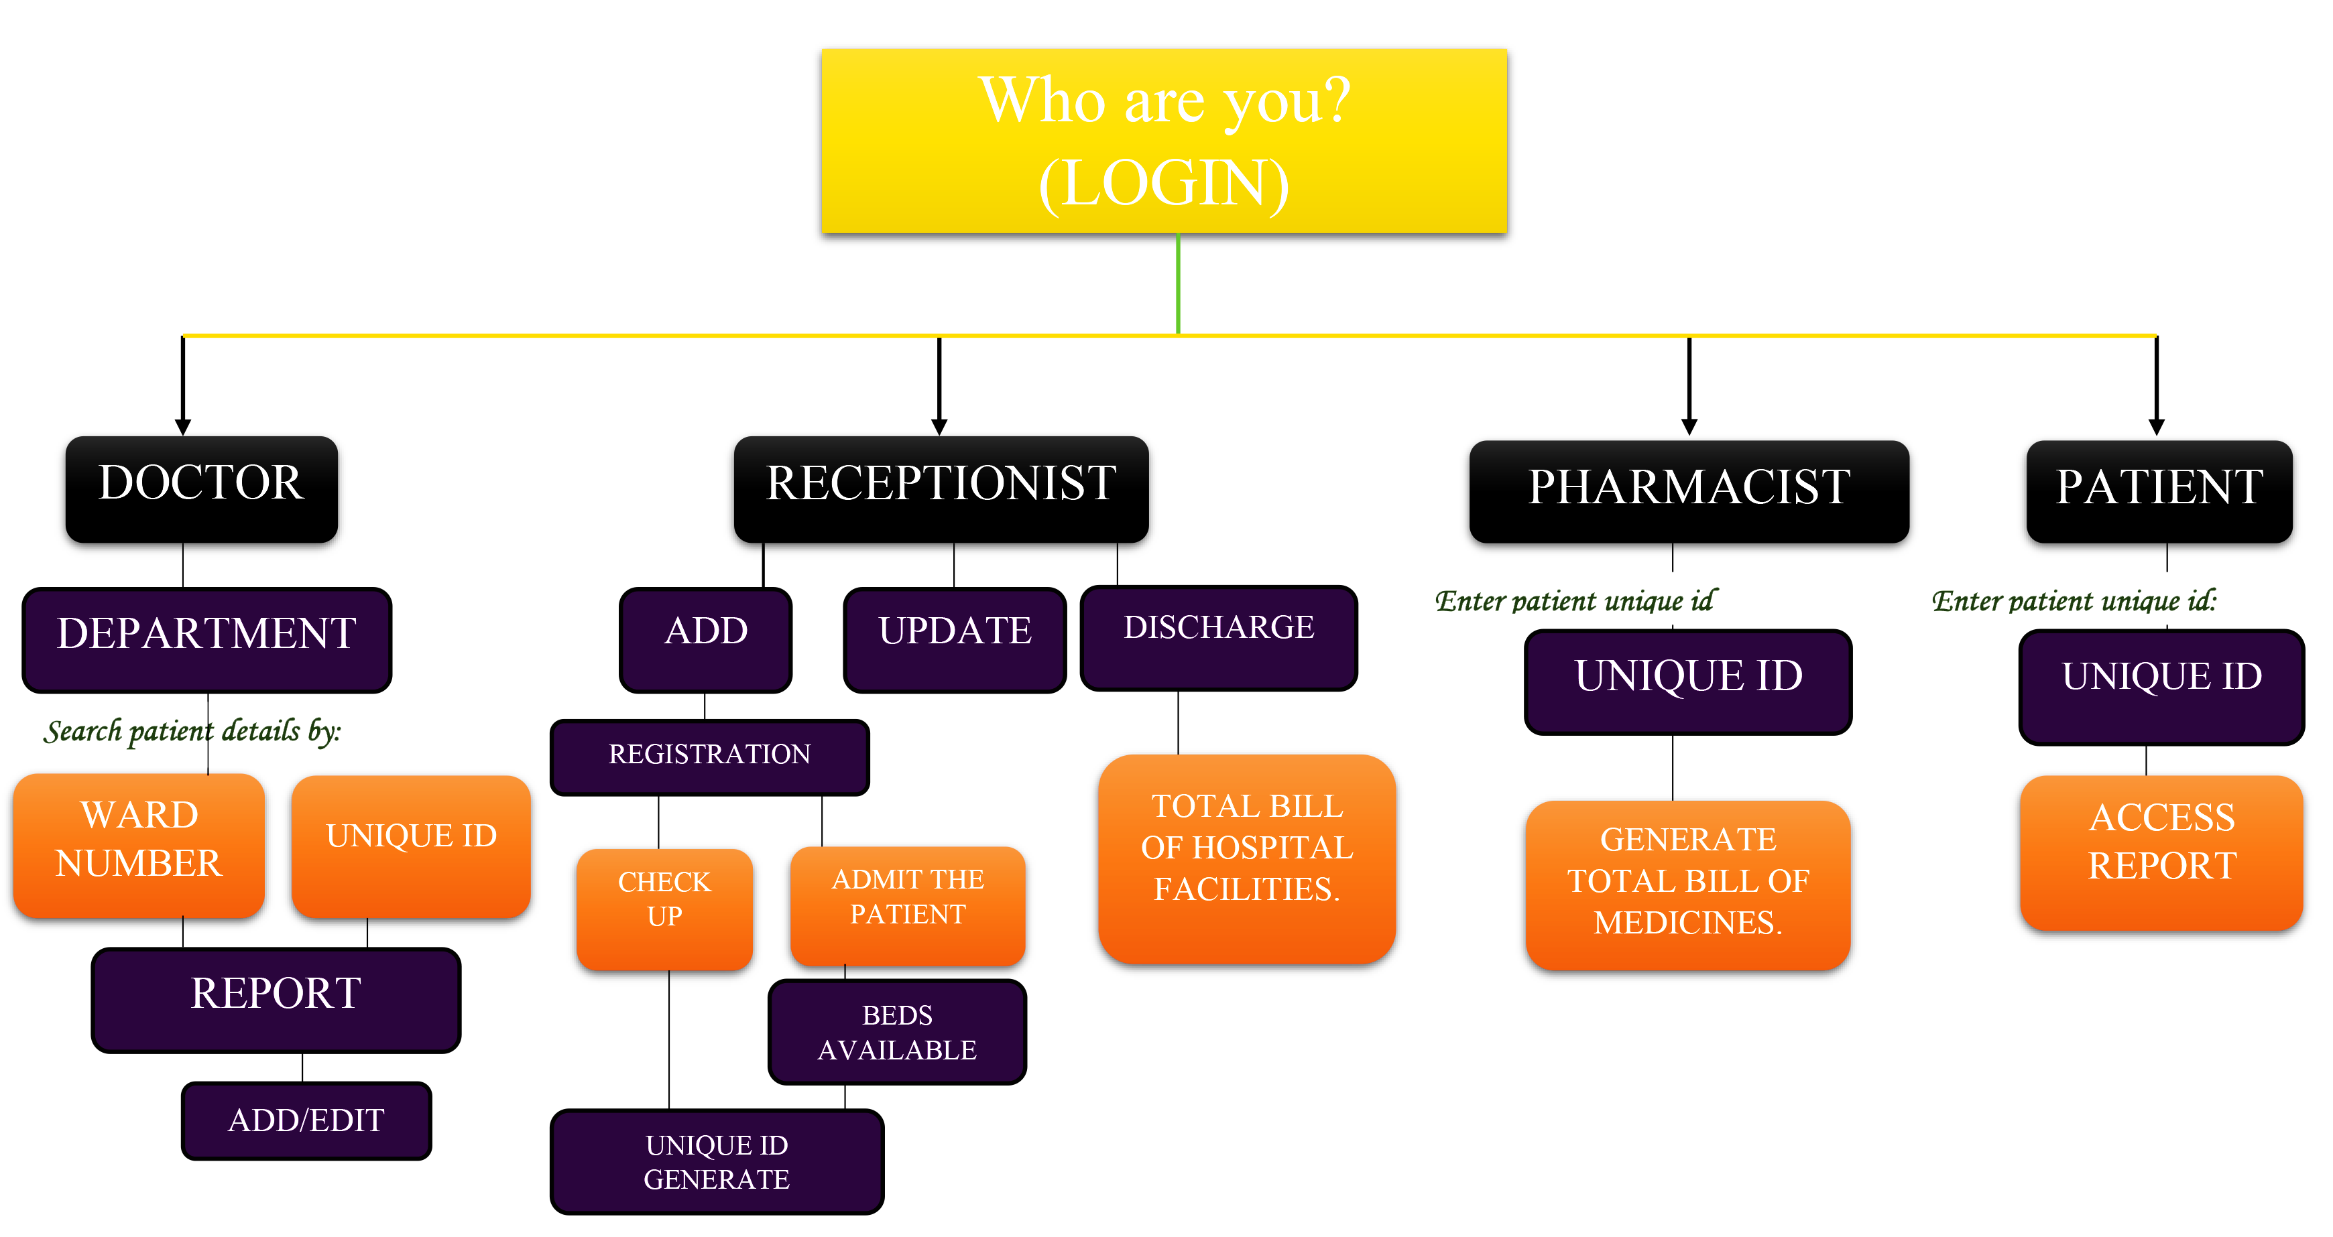

Slide 7

Record Excavators
Risha Sharma (Leader)
Adit Shrivastava
Garv Baheti
Sakshi Kashyap
rishasharma@jklu.edu.in
aditshrivastava@jklu.edu.in
garvbaheti@jklu.edu.in
sakshikashyap@jklu.edu.in

